Slide 1
Exploration of three political subreddits on Reddit
Comparison of the prediction factors for conservatives , liberals and politics reddits
By Harsha Goonewardana
Co-founder, DCData.Science

Slide 2

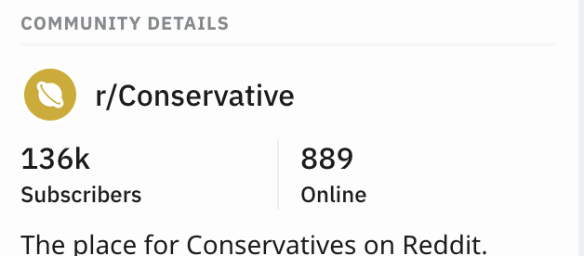
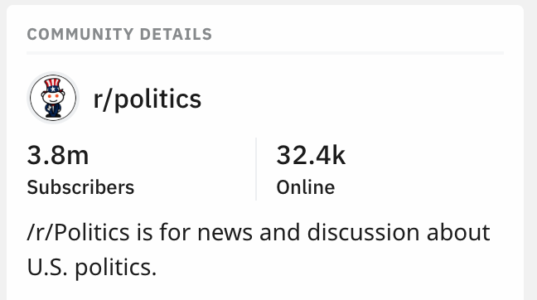
r/Conservative, r/Liberal & r/politics

Slide 3
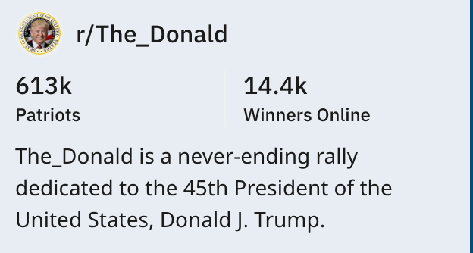

Slide 4
The datasets
r/Liberal 1658
r/Conservative 2184
r/politics 3382
Over one week

Slide 5
Best laid plans:
Assumption: r/politics = b1r/Conservative +b2r/Liberal + Error
Plan:
Train and evaluate algorithms on a combined Conservative + Liberal dataset
Select the model which can most accurately classify the labels
Classify submissions on the r/politics

Slide 6
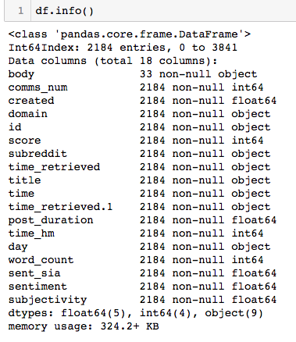
Feature set

Slide 7
Step 1: Select and train an algorithm to differentiate between Liberals and Conservative
Dataset = r/liberal+ r/conservative (Both Top and popular categories)
r/Liberal 1658
r/Conservative 2184
Method :Log Reg

Slide 8
Natural Language Processing Methodology
Remove punctuations and numbers
Lammatize
Vectorize
sentimentalize
Analyze

Slide 10
Word analysis
Credit :http://napitupulu-jon.appspot.com/posts/text-learning-ud120.html

Slide 11
Credit :http://napitupulu-jon.appspot.com/posts/text-learning-ud120.html

Slide 12
Natural Language Processing – Sentiment Analysis
Credit :https://www.aprenderpython.net/analisis-de-sentimientos-con-textblob-y-vader/

Slide 13
MY trusty assitant

Slide 14
Results : probability of predicting the class size
Train :0.897 Test: 0.815 Baseline rate =0.568

Slide 15
Classify r/politics - easy! Assumption: r/politics = b1r/Conservative +b2r/Liberal + Error
Unsupervised learning
How to check?

Slide 16
What would be a good proxy?

Slide 17
Domain names are unique df_pol[df_pol['pol_id']=='Liberal']['domain'].value_counts().head(12).plot(kind='bar');

Slide 19
Domain names are unique df_pol[df_pol['pol_id']=='Liberal']['domain'].value_counts().head(12).plot(kind='bar');

Slide 20
What happened?

Slide 21
Positive or negative
[('trump', 69), ('republican', 18), ('party', 13), ('house', 12), ('senate', 11), ('president', 11), ('free', 10), ('republicans', 10), ('special', 10), ('support', 10), ('kanye', 10), ('gop', 9), ('2018', 8), ('says', 8), ('race', 8), ('peace', 7), ('help', 7), ('win', 7), ('states', 7), ('united', 7)]
Positive or negative
[('trump', 198), ('gop', 37), ('democrats', 34), ('us', 29), ('republican', 27), ('gun', 27), ('says', 25), ('new', 25), ('media', 24), ('comey', 24), ('right', 23), ('left', 22), ('obama', 21), ('republicans', 21), ('u', 21), ('senate', 21), ('fbi', 20), ('president', 20), ('war', 20), ('house', 19)]

Slide 22
Positive
[('trump', 69), ('republican', 18), ('party', 13), ('house', 12), ('senate', 11), ('president', 11), ('free', 10), ('republicans', 10), ('special', 10), ('support', 10), ('kanye', 10), ('gop', 9), ('2018', 8), ('says', 8), ('race', 8), ('peace', 7), ('help', 7), ('win', 7), ('states', 7), ('united', 7)]
Negative
[('trump', 198), ('gop', 37), ('democrats', 34), ('us', 29), ('republican', 27), ('gun', 27), ('says', 25), ('new', 25), ('media', 24), ('comey', 24), ('right', 23), ('left', 22), ('obama', 21), ('republicans', 21), ('u', 21), ('senate', 21), ('fbi', 20), ('president', 20), ('war', 20), ('house', 19)]

Slide 23
Prediction Accuracy
r/politics
RandomForestClassifier(LogisticRegression 0.80
(CombineDFs(input_matrix, input_matrix), C=25.0, dual=True, penalty=l2), bootstrap=True, criterion=entropy, max_features=0.25, min_samples_leaf=18, min_samples_split=15, n_estimators=100)
r/Conservative
GradientBoostingClassifier: 0.72
(input_matrix, learning_rate=0.1, max_depth=2, max_features=0.35000000000000003, min_samples_leaf=9, min_samples_split=18, n_estimators=100, subsample=0.6500000000000001)
R/Liberal
BernoulliNBinomial 0.63
(OneHotEncoder(input_matrix, minimum_fraction=0.05, sparse=False), alpha=1.0, fit_prior=False) 57056694813028

Slide 24
Measuring success
Number of comments or
Score?
Both
Median used for both

Slide 25
conservative
politics
liberal

Slide 26
Word Length

Slide 29
r/politics
r/liberal
r/Conservative

Slide 30
r/politics

Slide 31
Tangential findings
r/poltics is more heterodox than expected
r/liberals have a wide variety of sources
r/conservatives love pictures

Slide 32
Next steps and self reflection
Increase model size
Make model pipeline first and then tune

